Slide 1
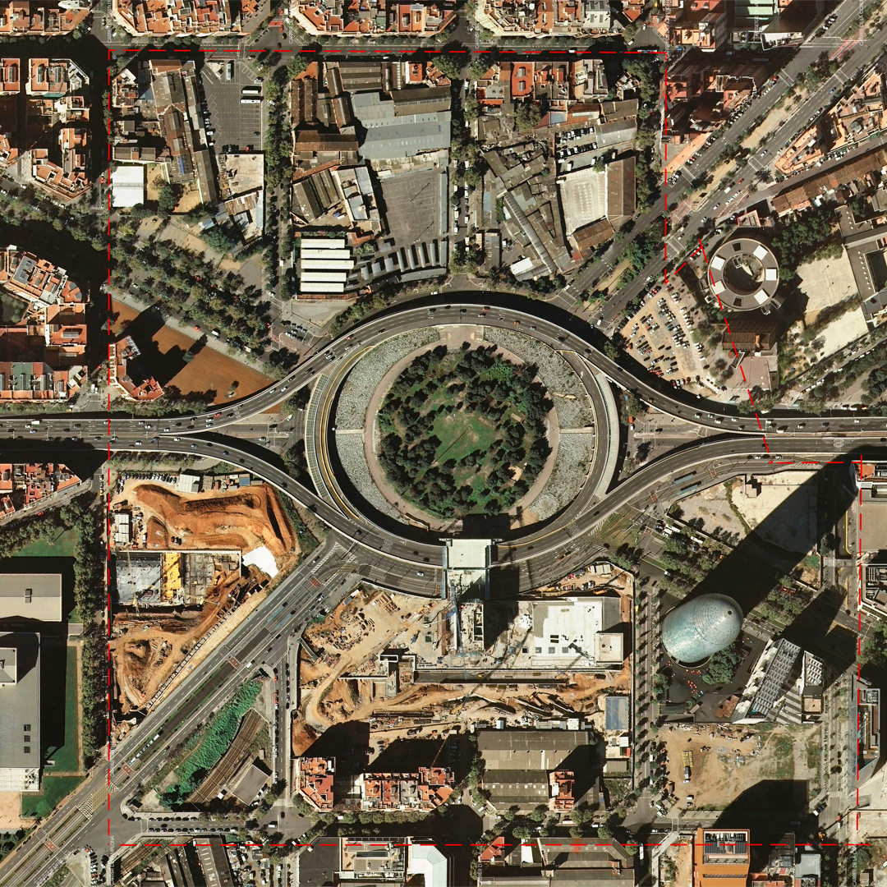
Barcelona Road traffic accidents: what happens in august?
Sabbah & Elliott

Slide 2
Project goals
Our playlist…
‘Here comes the summer sun’
‘A hard days night’
‘Working 9 to 5’
Skills used…
Locate
Understand
Pandas, SQL
Interrogate
Report

Slide 3
Data source
Who, why?
Open Data BCN
“Hem après català”
Where, what, when?
Repeating identifiers, UTF8, trailing white space
Process

Slide 4
ERD
accident
accident_id (Codi_expedient)
street_ID (Codi_carrer)
acc_desc (Descripcio_causa_vianant)
accident_location
accident_id (Codi_expedient)
X_coord (Coordenada_UTM_X)
Y_coord (Coordenada_UTM_Y)
longitude (Longitud)
latitude (Latitud)
accident_datetime
accident_id (Codi_expedient)
hour (Hora_dia)
day (Dia_mes)
month (Mes_any)
year (Any)
street
accident_id (Codi_expedient)
street_name (Nom_carrer)
suburb_name (Nom_barri)
district_name (Nom_districte)

Slide 5
Findings
Time (Hrs)
0 165
1 121
2 85
3 73
4 66
5 77
6 195
7 313
8 546
9 572
10 511
11 575
Time (Hrs)
12 535
13 677
14 704
15 615
16 625
17 622
18 659
19 605
20 579
21 427
22 352
23 231
Influence of month
10 - Oct 989
5 - May 874
7 - July 864
3 - Mar 862
4 - Apr 853
1 - Jan 851
6 - Jun 828
11 - Nov 805
12 - Dec 800
2 - Feb 770
9 - Sep 751
8 - Aug 683
Influence time of day

Slide 6
Findings
Time (Hrs) #
0 15
1 16
2 6
3 5
4 11
5 8
6 18
7 36
8 61
9 64
10 56
11 51
Time (Hrs) #
12 43
13 61
14 75
15 55
16 66
17 79
18 58
19 57
20 53
21 30
22 43
23 22
AUGUST – BY HOUR
Time (Hrs) #
0 16
1 10
2 13
3 7
4 4
5 9
6 21
7 17
8 26
9 30
10 35
11 47
Time (Hrs) #
12 38
13 59
14 48
15 50
16 39
17 42
18 37
19 29
20 31
21 27
22 29
23 19
OCTOBER– BY HOUR

Slide 7
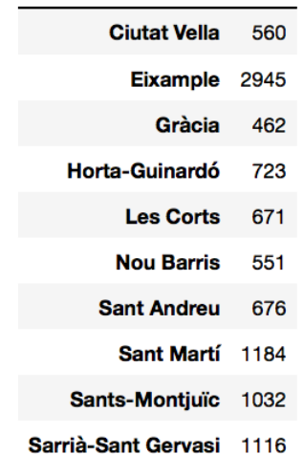
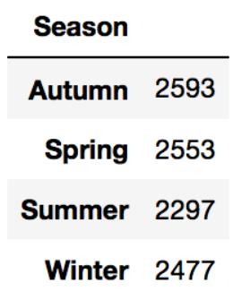
Findings
Influence of SEASONS
District

Slide 8
Learning & Further research
We’re smart…
Clean data in Pandas
Create AWS DB
Pandas -> SQL
Created relational DB
But could be smarter…
Look at multiple years
Overlay different data sets

Slide 9
Proposed ERD for future improvements
accident
accident_id (Codi_expedient)
street_ID (Codi_carrer)
acc_desc (Descripcio_causa_vianant)
accident_location
accident_id (Codi_expedient)
X_coord (Coordenada_UTM_X)
Y_coord (Coordenada_UTM_Y)
longitude (Longitud)
latitude (Latitud)
street
Street_ID (Codi_carrer)
street_name (Nom_carrer)
suburb_name (Nom_barri)
district_name (Nom_districte)
driver_vehicle
Codi_expedient
unique_ident (to be derived from accident_ID
vehicle_type (Descripcio_tipus_vehicle)
vehicle_model (Descripcio_model)
vehicle_manuf (Descripcio_marca)
vehicle_colour (Descripcio_color)
(license_type (Descripcio_carnet)
years_driving (Antiguitat_carnet)
accident_datetime
accident_id (Codi_expedient)
hour (Hoa_dia)
day (Dia_mes)
month (Mes_any)
year (Any)

Slide 10
Thank you!

